Slide 1

Laptop Price Prediction
By :-
Kathan Teldhune
Sai Kiran Earla
S Parashivamurthi Chavan

Slide 2
Introduction
This project is based on laptop price prediction, where we classify the laptop price based on the specifications of the laptop.
The goal of this project is to accurately predict the prices of laptops based on the various features.

Slide 3
Agenda
Problem Statement
Data Mining
Data Cleaning
Data Visualization
Feature Engineering
Predictive Modeling

Slide 4
DATA
VISUALIZATION

Slide 5
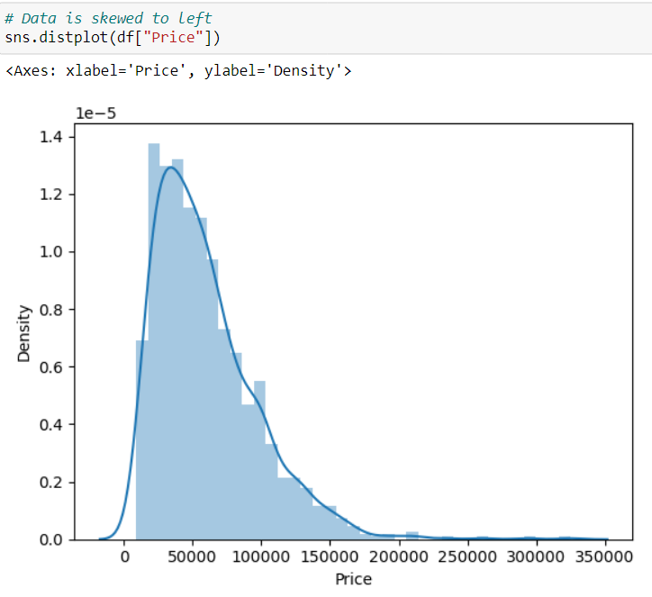
Plotting distplot for target column - Price

Slide 6
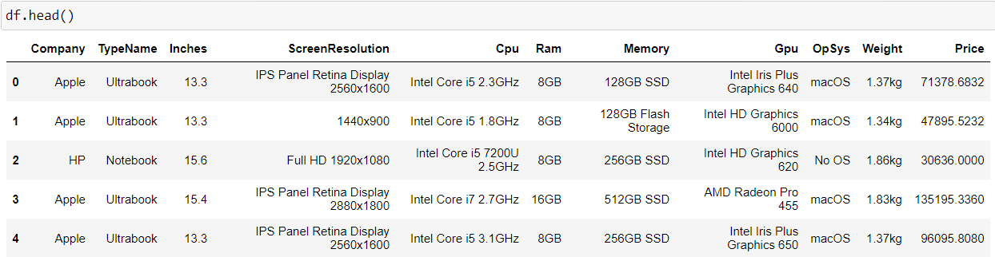
Problem Statement
Attribute Information
The problem statement is that if a customer wishes to buy a laptop, our model should be able to deliver a preliminary price based on the user's parameters. Despite the fact that it appears to be a basic project or a growing model, the dataset we have is raw and requires extensive feature engineering.

Slide 7
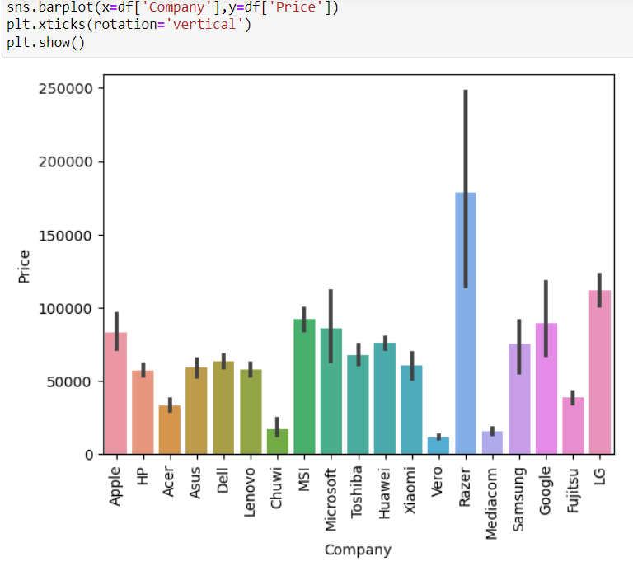
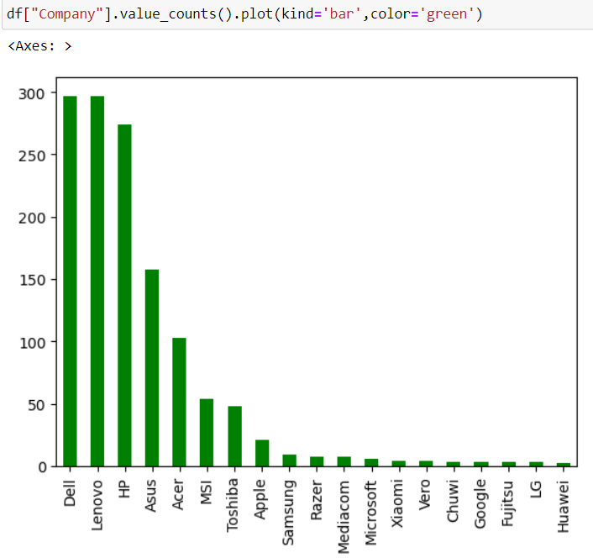
Comparing the Company column with the Target column(Price)

Slide 8
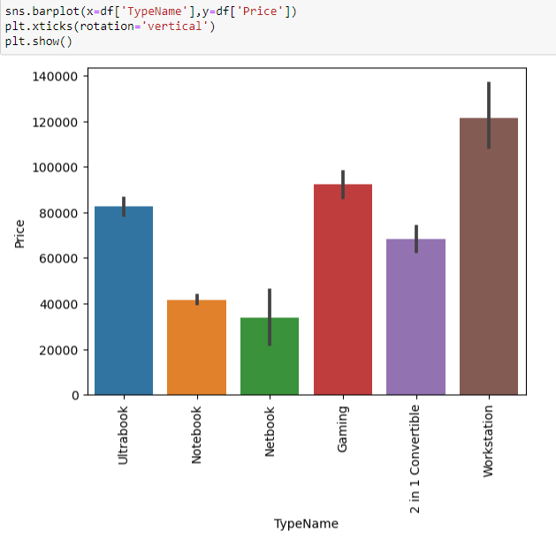
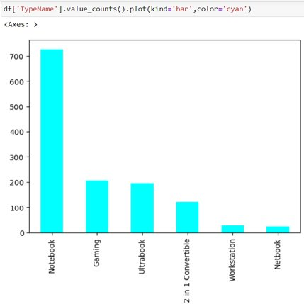
Comparing TypeName column with the Target column.

Slide 9
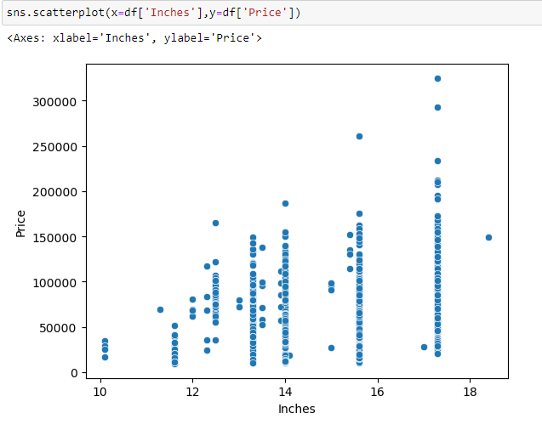
Plotting a scatterplot of Inches column with the Target column

Slide 10
FEATURE
ENGINEERING

Slide 11
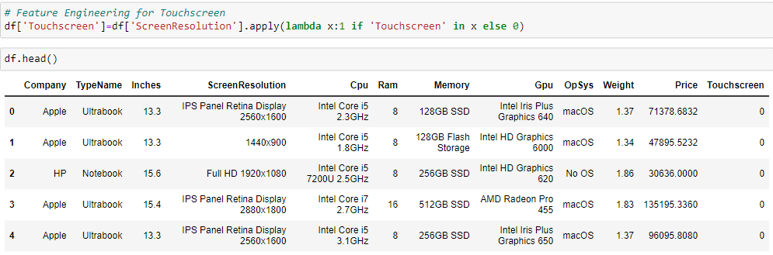
Extracting data from Screen Resolution column, named as Touchscreen column.

Slide 12
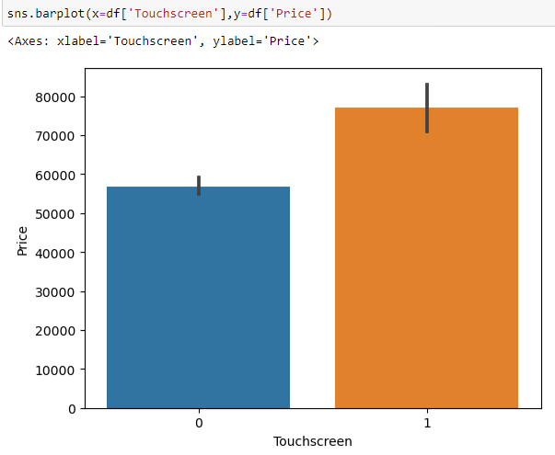
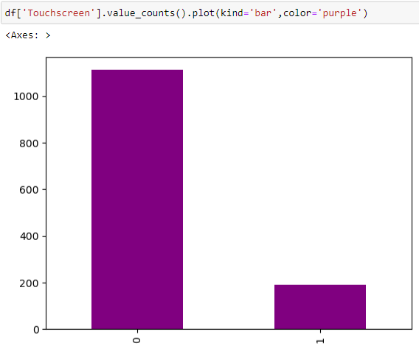
Comparing the Touchscreen column with the Target column.

Slide 13
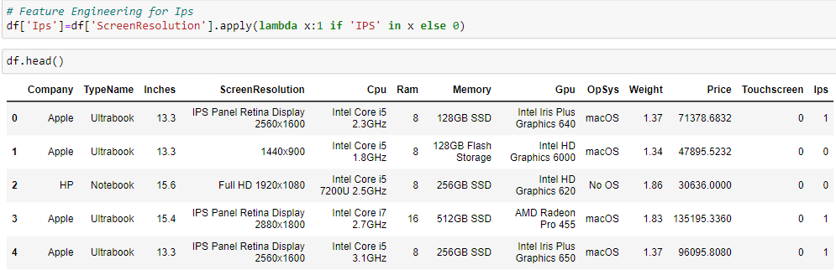
Extracting data from Screen Resolution column, named as Ips column.

Slide 14
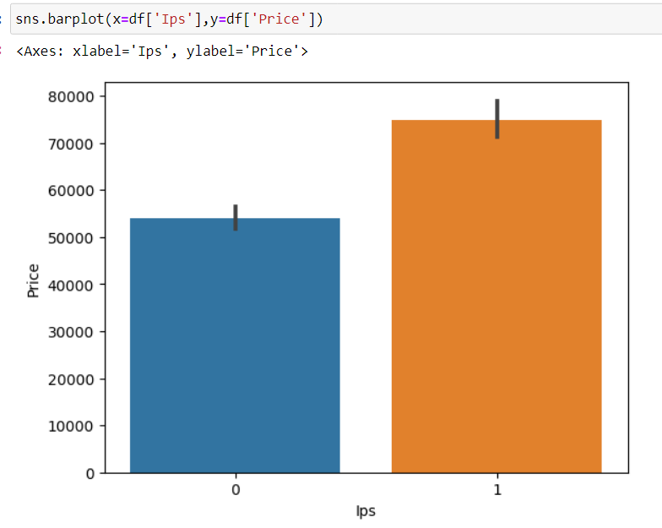
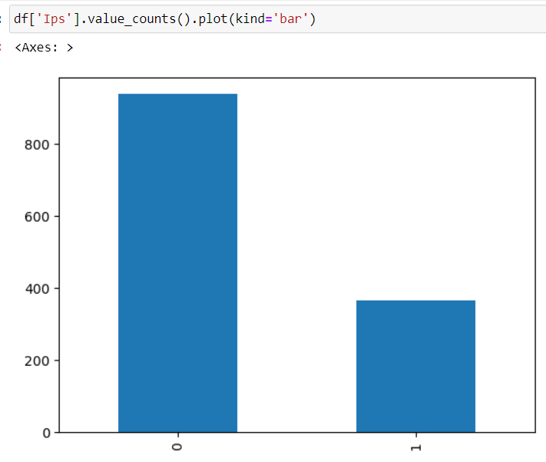
Comparing Ips column with the target column.

Slide 15
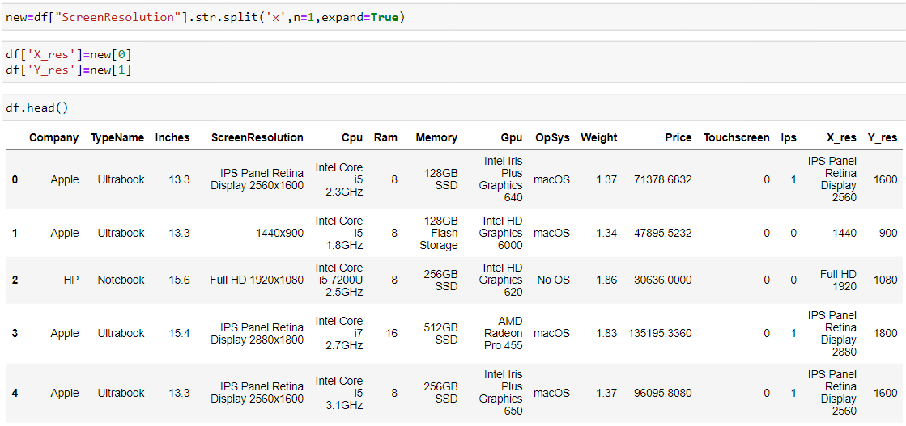
Extracting two new columns named as X res & Y res from Screen resolution.

Slide 16
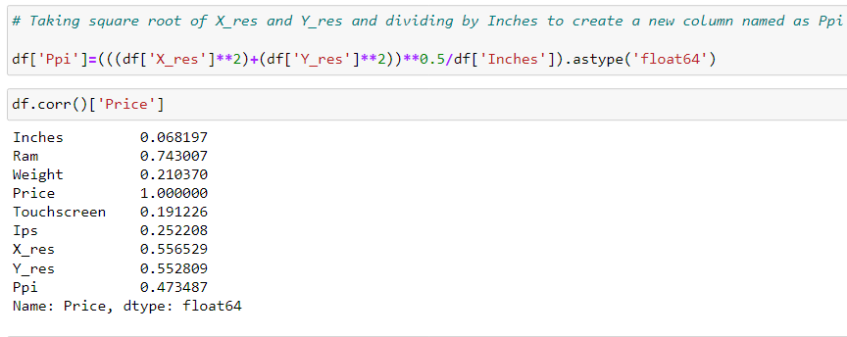
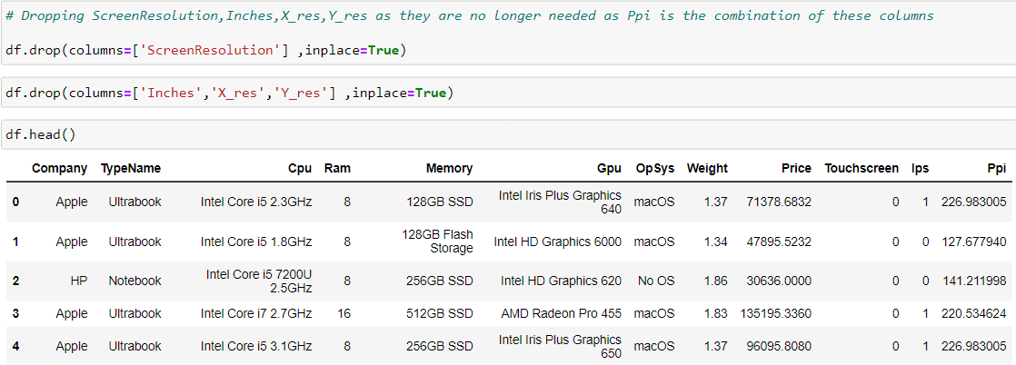
By taking the square root of X and Y and dividing by inches, a new column called Ppi is created.

Slide 17
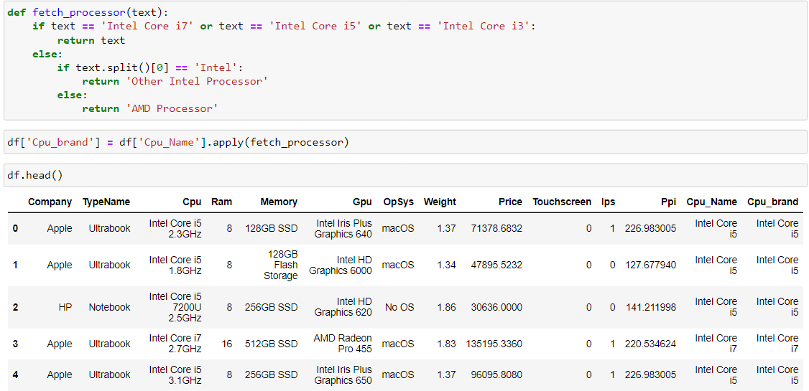
Creating a function to extract first three words from Cpu Name column and reassigning it as Cpu Brand.

Slide 18
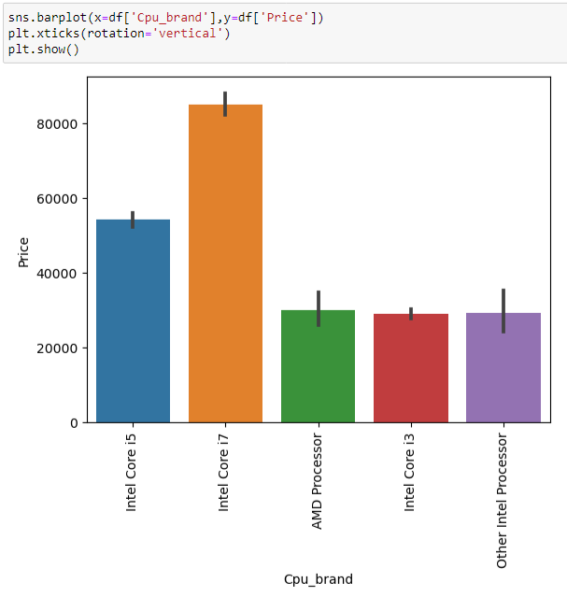
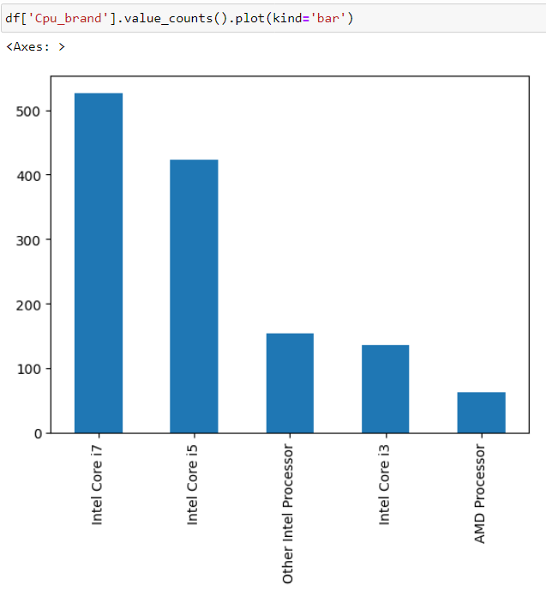
Comparing Cpu Brand column with the target column.

Slide 19
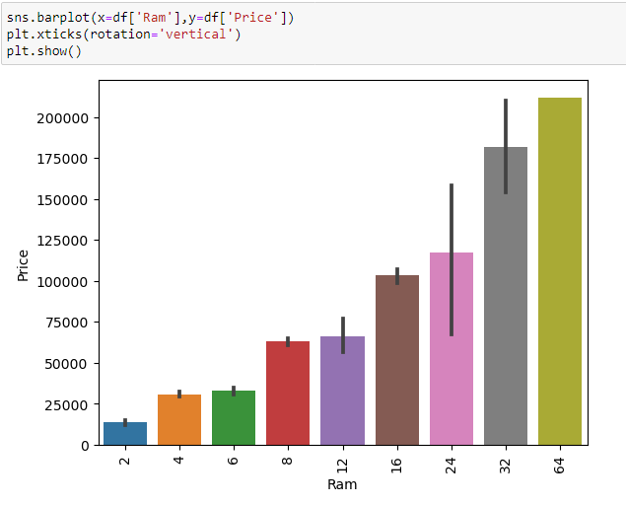
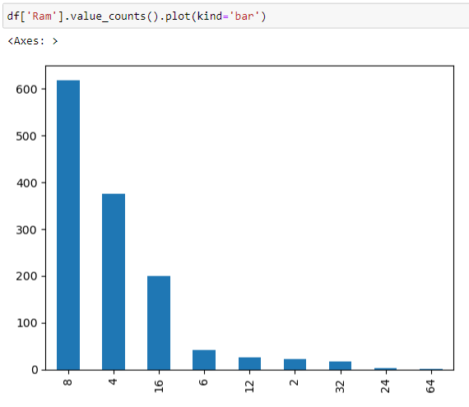
Comparing Ram column with the Target column.

Slide 20
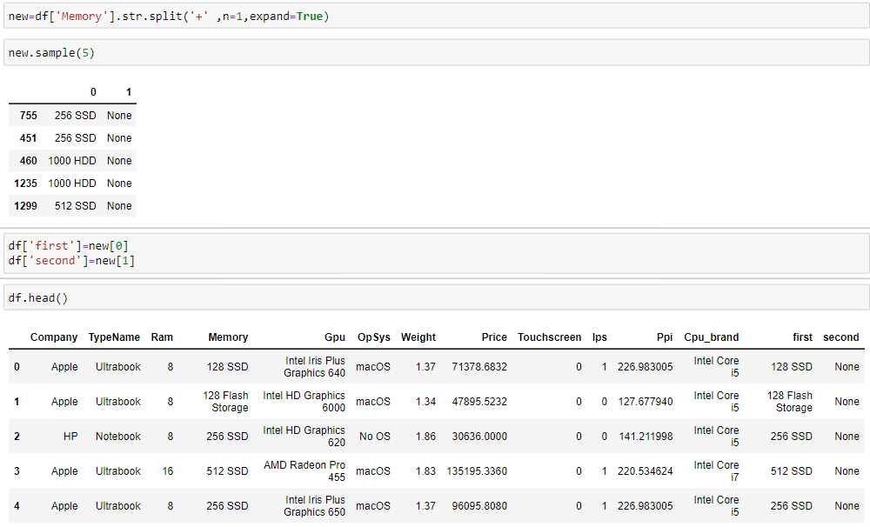
Splitting the memory column to separate the SSD & HDD, then allocating them as the first and second columns.

Slide 21
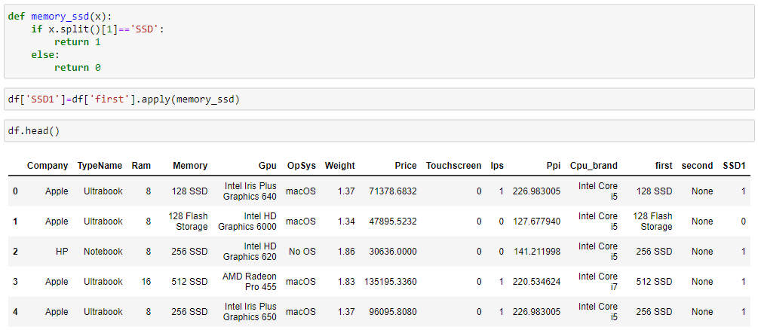
Creating a function to add the SSD column and following the same process for the HDD, Flash storage, and hybrid columns.

Slide 22
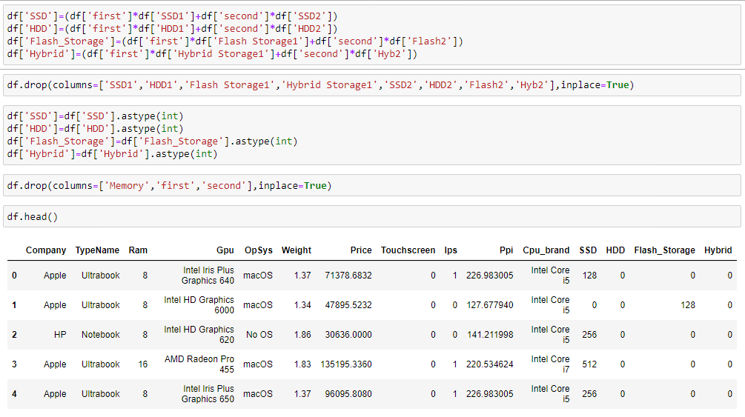
Extarcting SSD, HDD, Flash storage, Hybrid column from Memory column.

Slide 23
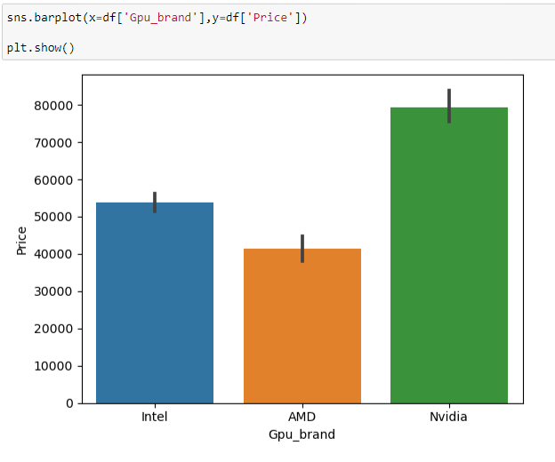
Comparing Gpu Brand with the target column.

Slide 24
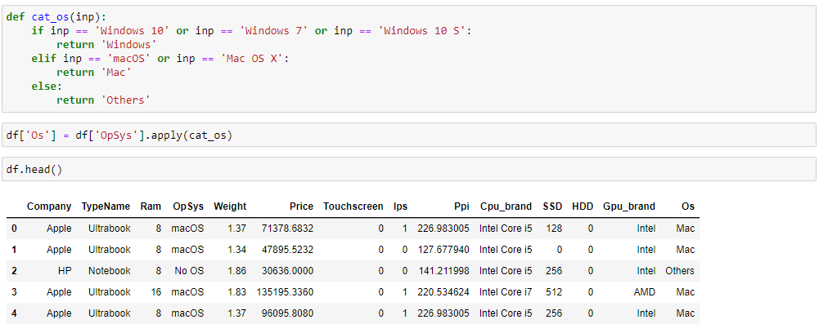
Creating a function to extract first word from OpSys column and reassigning it as OS.

Slide 25
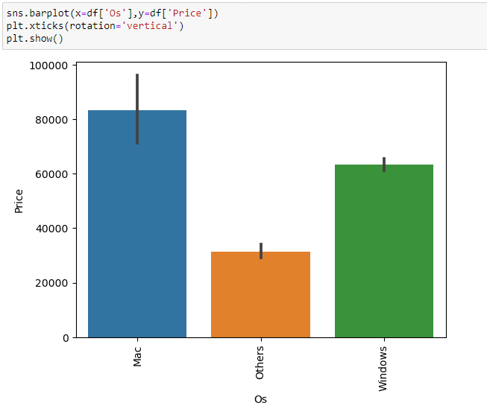
Comparing OS column with target column.

Slide 26
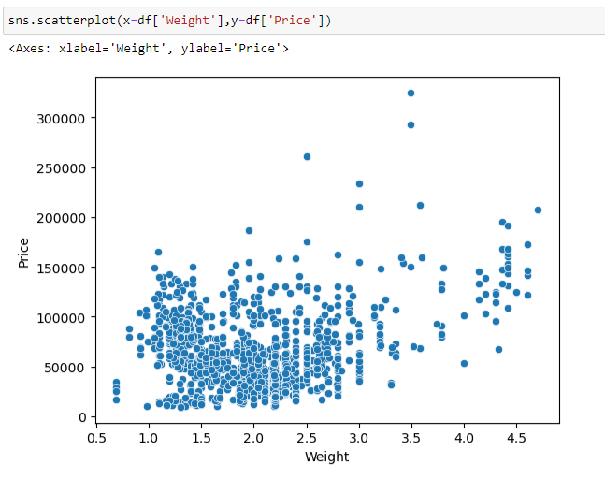
Plotting a scatterplot to check the difference between Weight & Price column.

Slide 27
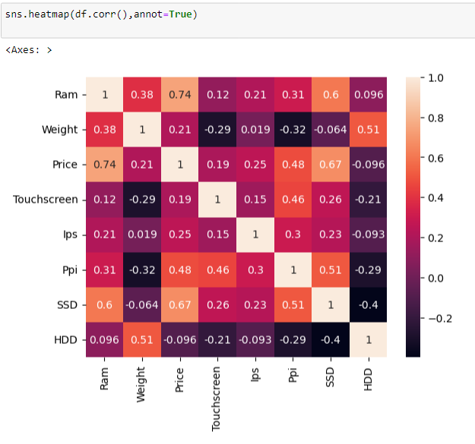
Heatmap
Correlation between variables

Slide 28
PREDICTIVE
MODELING

Slide 29
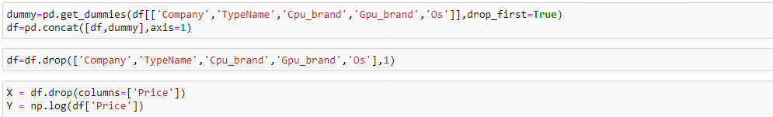
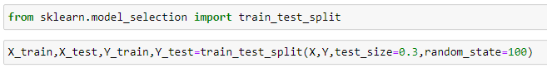
Obtaining dummy values for categorical data to transform into continuous variables.

Slide 30
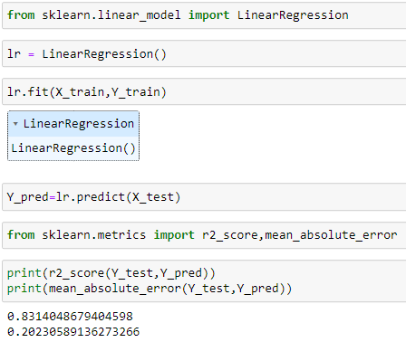
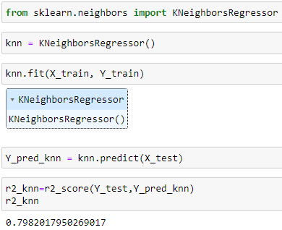
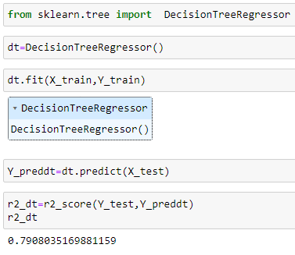
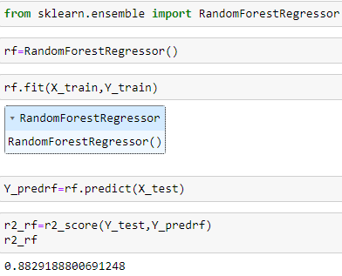
Linear Regression
2. K Nearest Neighbor
3. Decision Tree
4. Random Forest

Slide 31
THANK YOU !!!

